Slide 1


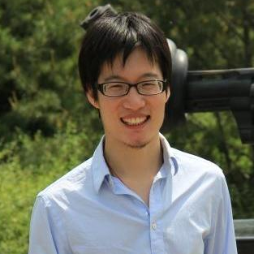
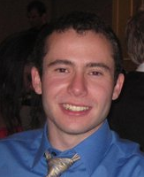
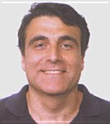


Catchsync: catching synchronized behavior in large directed graphs
Meng Jiang, Tsinghua University, Beijing, China
Joint work with Peng Cui, Alex Beutel,
Christos Faloutsos and Shiqiang Yang
August 26, 2014 – NYC, USA
Notes:
Hello everyone, I am Meng from Tsinghua. Our work is about fraud detection. It’s not about differential privacy, but thanks for the talks. I learned a lot. Here our paper is CatchSync: Catching Synchronized Behavior in Large Directed Graphs. This is a joint work with Peng and Shiqiang from Tsinghua, Alex and Christos from CMU.

Slide 2







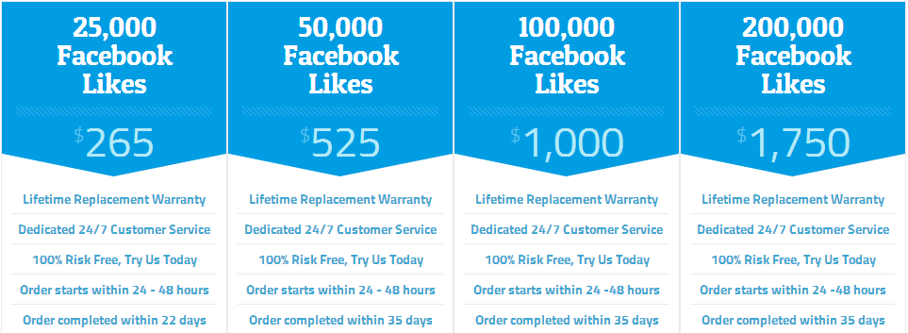

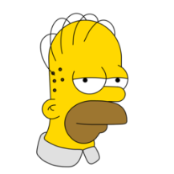
Fraud Detection: Graph Analysis Problem
[www.buyfollowz.org]
[buymorelikes.com]
Notes:
Fraud detection is an important problem for applications like social networks. As the advertisements show here, there are some companies selling Twitter followers and Facebook “Likes” to inflate those numbers of their customers. How to catch the fraudsters can be considered as a graph analysis problem. We are looking for anomalous edges that are created by fraudulent behaviors in the large graphs. For example, here we are trying to distinguish the Twitter botnets from the Simpson family. Also, for my talk, it’s not easy to get Likes from you. But it would be different if I pay you.

Slide 3




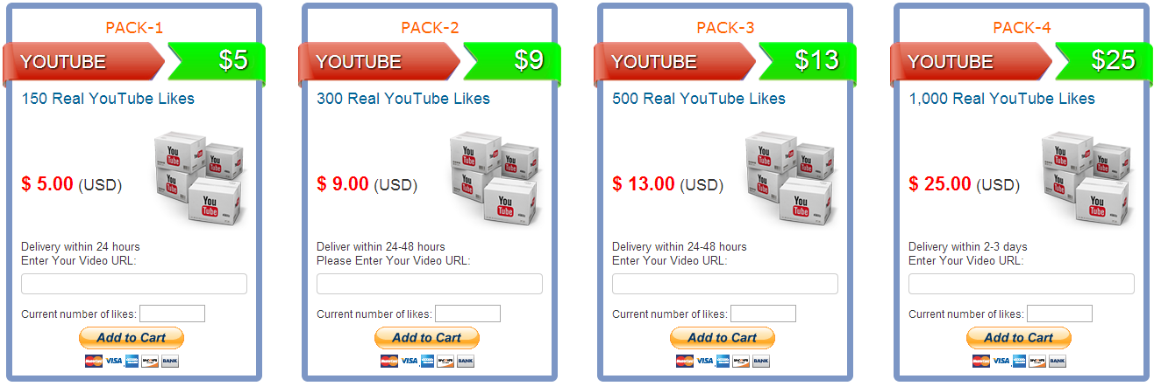


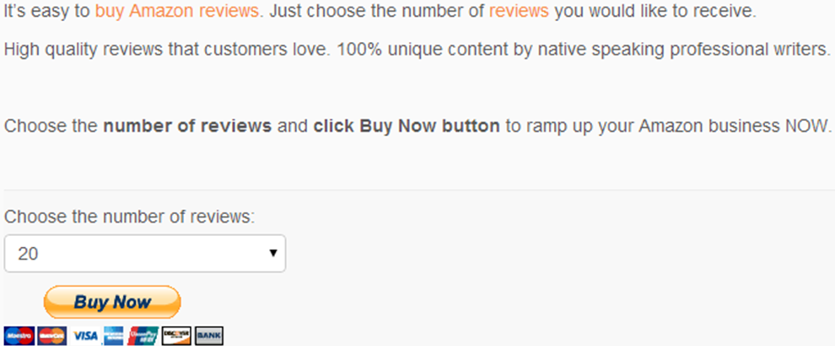



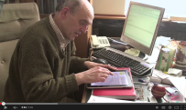
Fraud Detection: Graph Analysis Problem
[buycheaplikes.com]
[reviewsteria.com]
Notes:
Similar things happen in YouTube and Amazon. There are some companies selling YouTube Likes and 5-star reviews. Detecting the videos which buy fraudsters to look popular can also be formulated as a graph analysis problem.

Slide 4
Our Goals
Given: A graph (large-scale, directed, etc.)
Find: Frauds = Anomalous edges
Goals:
G1. Find patterns that distinguish fraudsters from normal users
G2. Design algorithms that catch fraudsters
Notes:
So here are our goals. Given us a graph. It could be very large. It could be directed or bi-partite. How can we find the frauds that create anomalous edges? Our goals towards this problem are: first, to find the patterns that can distinguish fraudsters from normal users; second, we want to develop an algorithm that can catch the fraudsters.

Slide 5
Outline
1. Background
2. Fraudulent Pattern
3. The Algorithm
4. Experiments
Notes:
Here is the outline of this talk. First I will give the background knowledge. Then I will talk about the fraudulent patterns we discover. The third will be our CatchSync algorithm. And then I will give the experimental results. Let’s first take a look at the background.

Slide 6
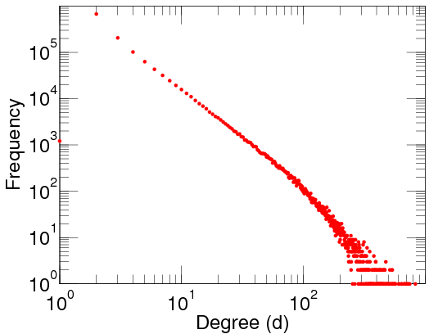
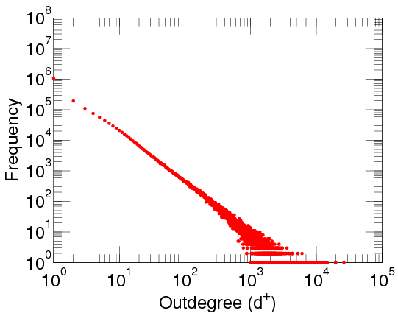
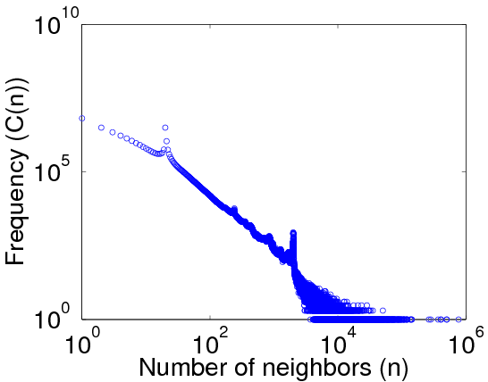
Anomalies in Degree Distributions
Power-law distribution
DBLP Author-publication | Flickr User-user | Twitter Who-follows-whom
[konect.uni-koblenz.de/networks/]
Notes:
If there are fraudsters manipulating the social graphs, the graph structure can be distorted. Let’s have a look at the out-degree distributions of these graphs. The figures are from a website in Germany called KONECT. The X-axis is out-degree, for example, how many accounts a user follows. The Y-axis is the count of the users. The figures are plotted in log-log scale. You can see the DBLP and Flickr networks show smooth power-law distributions. But the Twitter graph shows some spikes. There must be some anomalies.

Slide 7
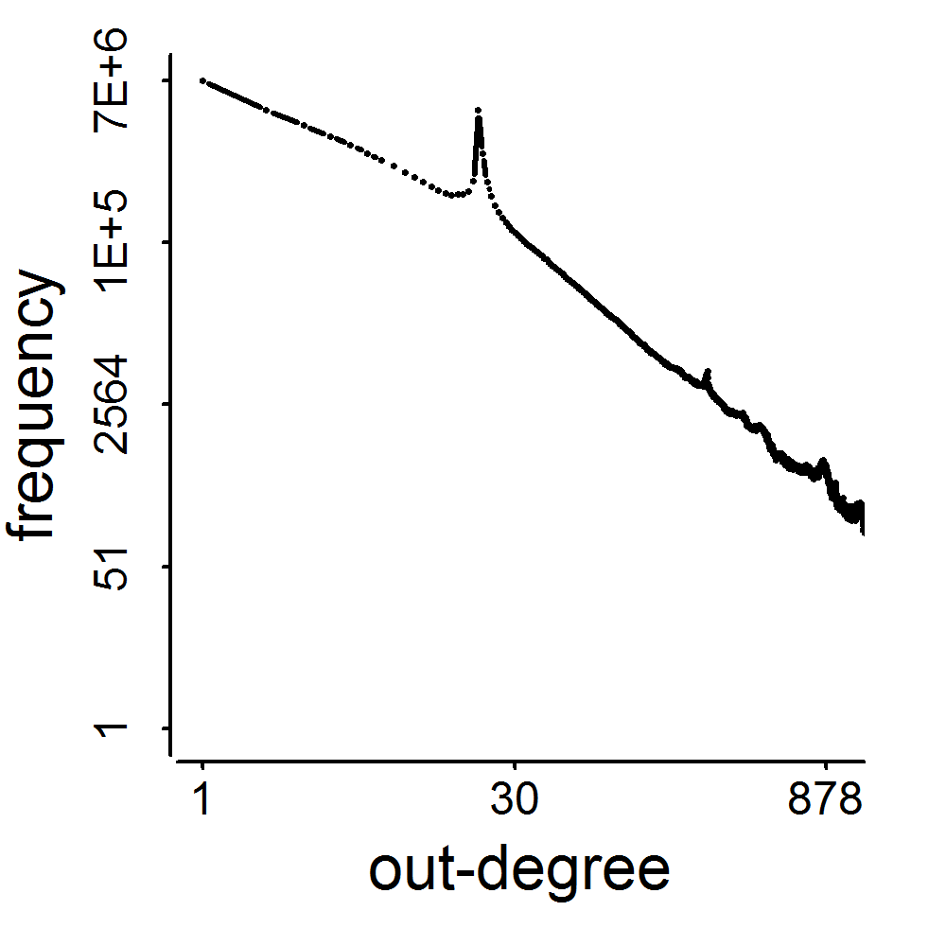
Anomalies in Degree Distributions
2009
3.17M
0.41M
41M
d=20
Notes:
Let’s replot the distribution to make it look clear. In the Twitter 2009 graph with 41 million nodes, we can see a spike of almost 3 million nodes in the out-degree distribution at degree 20. We can also see some other spikes.

Slide 8
Linear Classifier with “Degree”: Fail
+1
(Fraud)
=20?
3.17M
0.41M
Label (+1,-1) | Out-degree
classifier
d=20
×
Notes:
If we build a linear classifier with the out-degree values to catch the fraud, it will fail. So the spikes can tell us the existence of anomalies but they cannot give us the way to catch them.

Slide 9

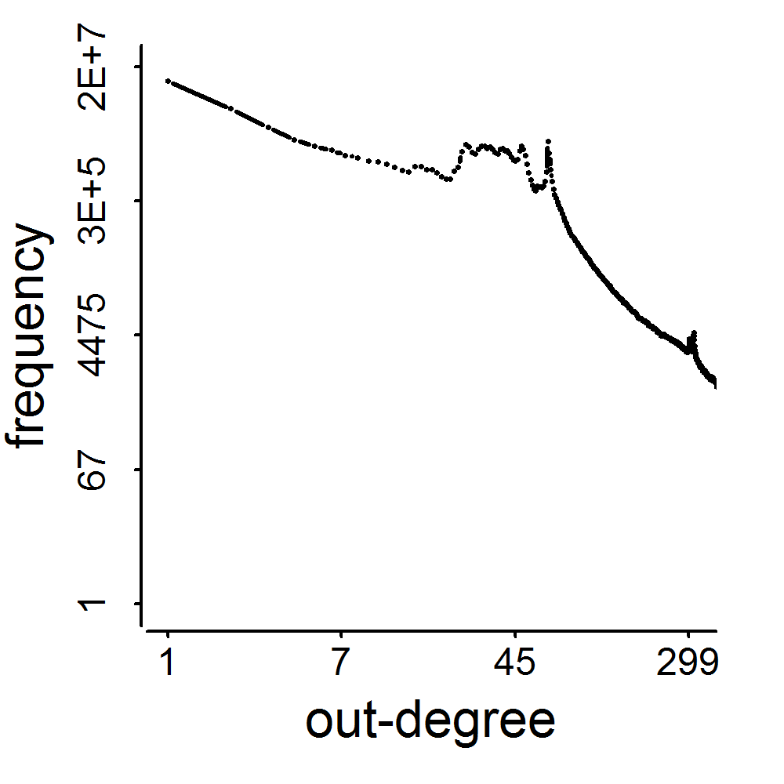
Graph Structure Distorted
2011
1.91M
117M
0.44M
d=64
Notes:
The anomalies do not only happen on Twitter. In Tencent Weibo, a Twitter-style website in China, we can also see spikes on its out-degree distribution. The graph structure is also distorted.

Slide 10
Traditional Fraud Detection
+1
(Fraud)
Big?
Small?
Big?
Big?
Big?
Label (+1,-1) | Out-degree | In-degree | #tweet | #url in tweets | #hashtag in tweets
Content-based
features
classifier
Notes:
The traditional fraud detection methods collect a number of features of account and use supervised or semi-supervised algorithm to classify the account. For example, if a user has lots of followees, which means the out-degree is big, it has a high probability to be a fraudster. Other clues can be a small number of followers because fraudsters are usually not attractive. Also, if a user posts lots of tweets, lots of url links or lots of hashtags in his tweets, he is probably a fraudster. However, in fact, the web is more complex. Let’s see some examples.

Slide 11
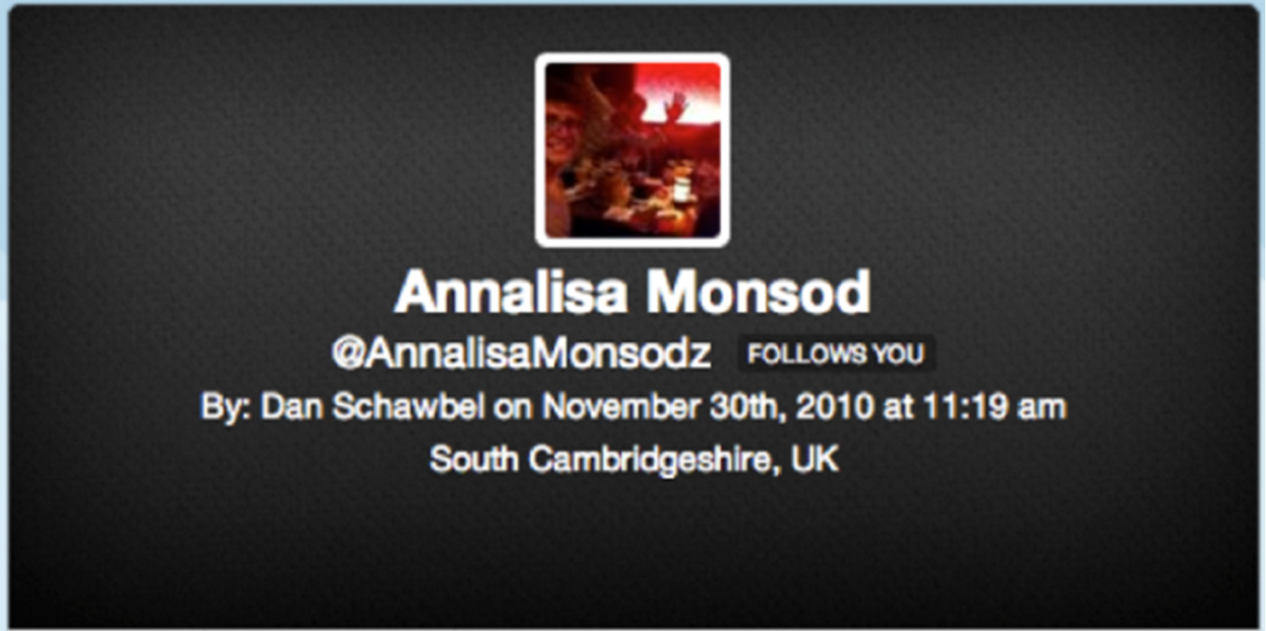
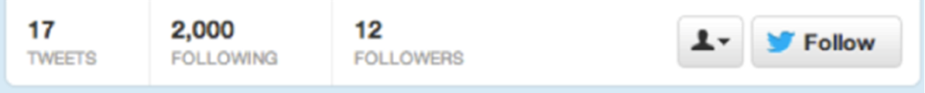
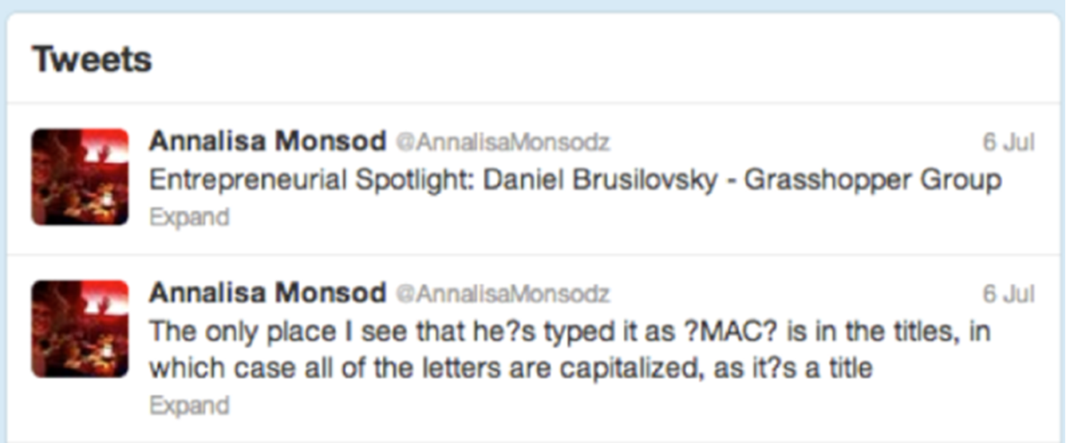
Empty Profile?
Notes:
The fake accounts are usually smart. See here is one from a group that were bought by a researcher with 5 dollars. He shows the fake accounts in his personal website for some study. It has lots of profile information with nice photo and nice self-introduction. It has only 17 tweets. There is no url and hashtag in the 17 tweets. With the content , it’s hard to say this account must be a fraudster.

Slide 12
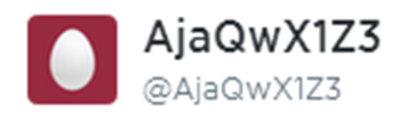
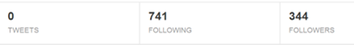
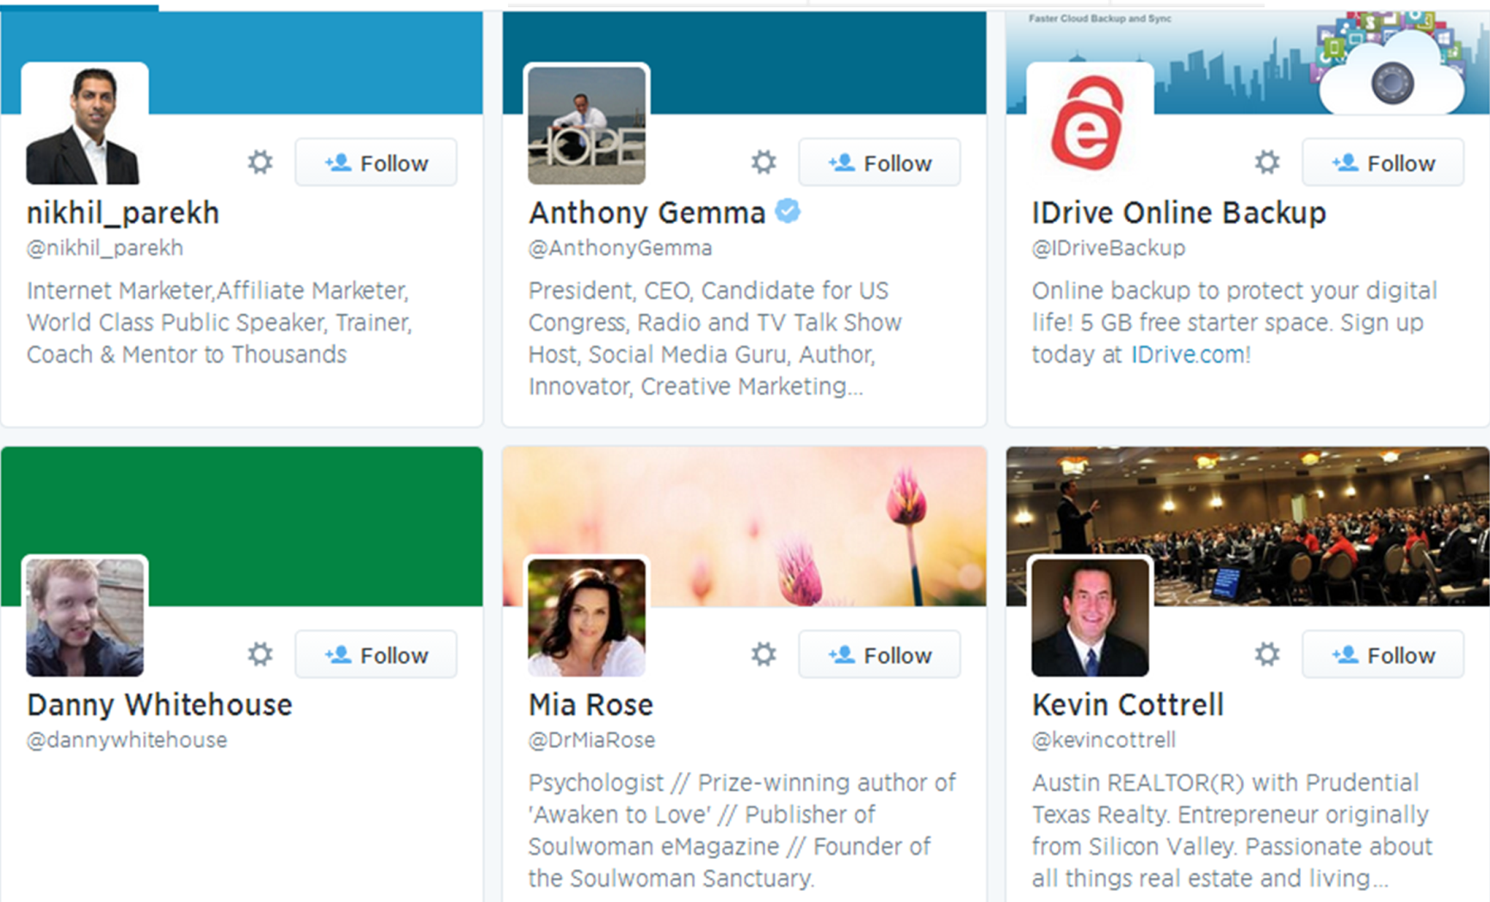
Few Followers?
Notes:
Here is another example. The name is very suspicious. It’s exactly a fraudster. It follows lots of Internet Marketers and shopping sites. But it looks popular. It has 344 followers. This big value of in-degree will make the classifier confused.

Slide 13
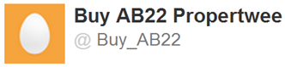
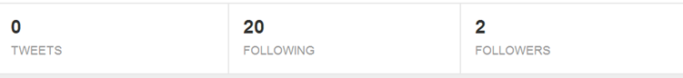
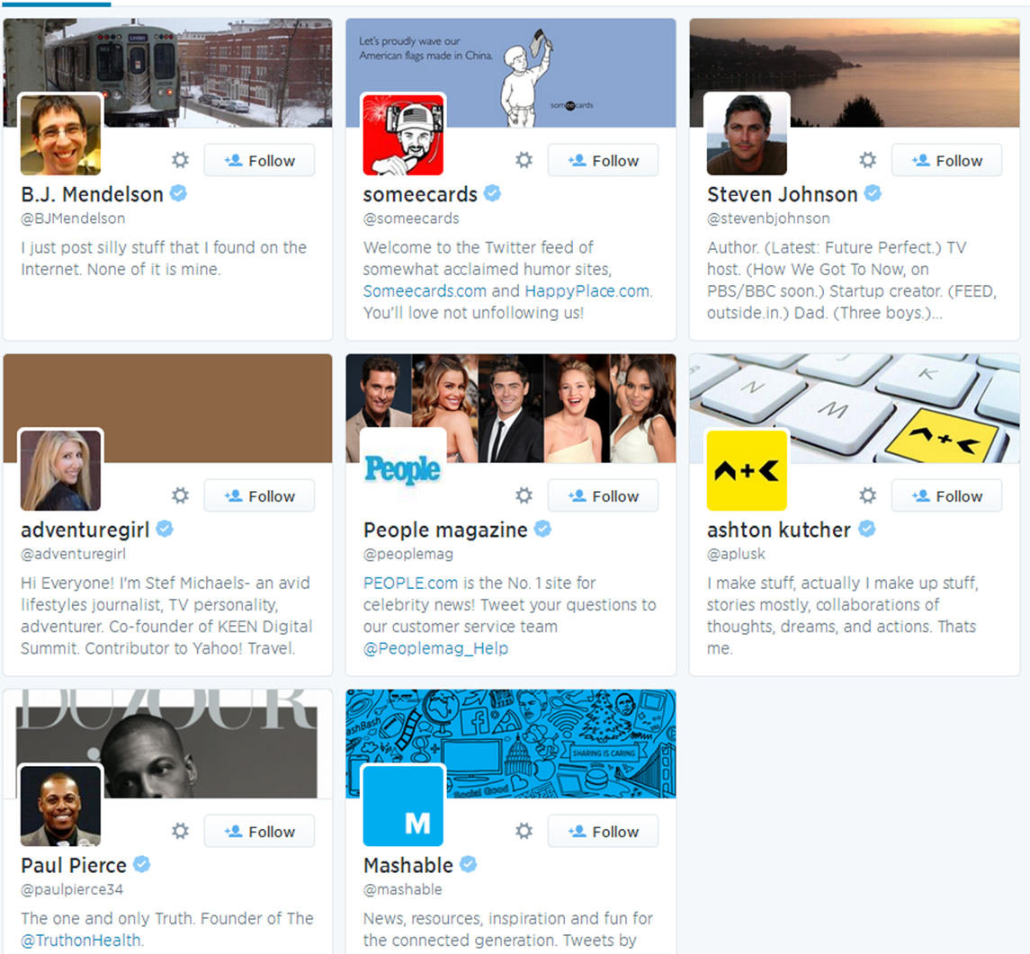
Many Followings?
Notes:
The fraudsters do not have to show big out-degree. Here is an example. His name is Buy_AB22. It has only 20 followees and zero tweet. Lots of his followees are Internet marketers.

Slide 14
Content: Unavailable? Look Normal?
0, 0, 0… sorry
Label (+1,-1) | Out-degree | In-degree | #tweet | #url in tweets | #hashtag in tweets
Content-based
features
classifier
Notes:
If the content is not available or the fraudsters are smart to fake their content, sorry, linear classifier cannot catch them.

Slide 15
Behavior is the Key
Monetary Incentive
Content
what they appear to behave
Behavior/Links
what they have to behave
Notes:
We notice that the suspicious content is what the fraudsters appear on the network, while for their monetary incentives, their connecting behaviors or their links should be what they have to behave. Catching fraudulent behaviors is the natural way, the key to catch the fraudsters. We have to study this behavior pattern instead of the content-based features.

Slide 16
Outline
1. Background
2. Fraudulent Pattern
3. The Algorithm
4. Experiments
Notes:
Now let’s see what is the pattern of fraudulent behavior.

Slide 17
Behavior-based Features
Follower
behavior
Followee
behavior
≈
≈
Out-degree
1st left singular vector
(Hubness)
2nd left singular vector
…
In-degree
1st right singular vector
(Authoritativeness)
2nd right singular vector
…
Notes:
To understand the behavior patterns, we first collect some behavior-based features. The behaviors could be follower behavior when we focus on out-going links and followee behaviors when we focus on in-coming links. If we do SVD on the adjacency matrix, the out-going links give us left singular vectors and the in-coming links give us right singular vectors. Here we use the two basic features of each type of links: out-degree and hubness which is the 1st left singular vector for follower behavior, and in-degree and authoritativeness which is the 1st right singular vector for followee behavior.

Slide 18
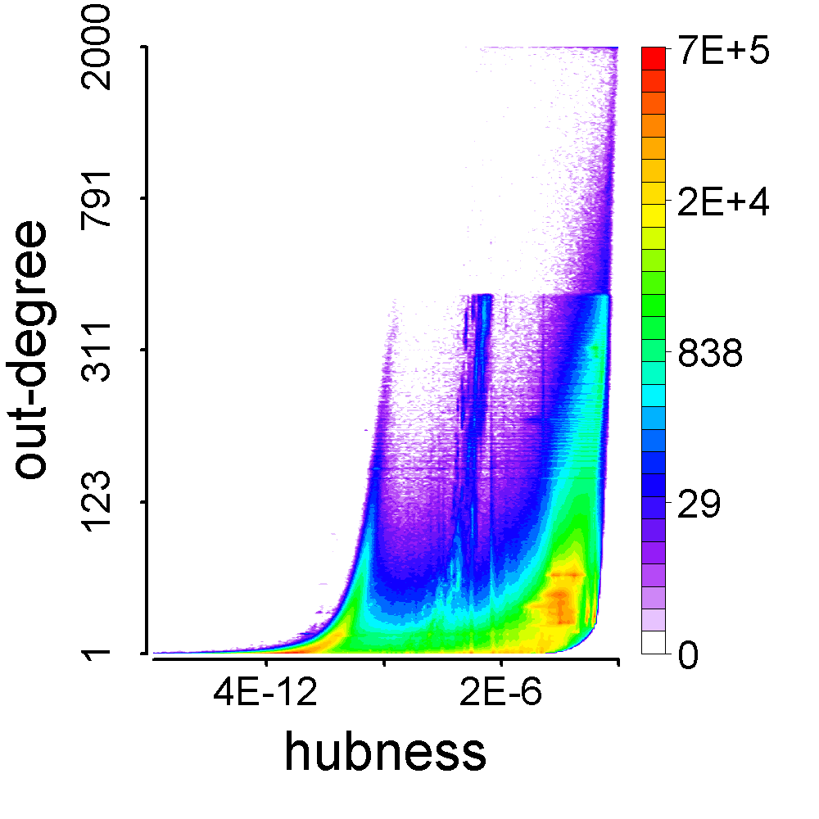
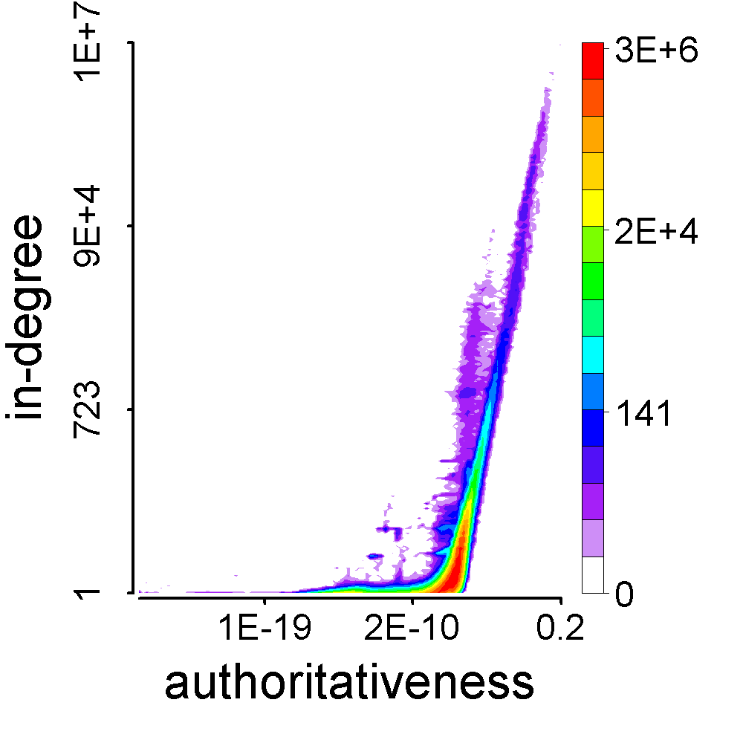
Behavior-based Feature Space
Follower
behavior
Followee
behavior
Notes:
Then we can plot the feature space of follower behavior and followee behavior. These are heat maps. X-axis is singular vector value and Y-axis is the degree. Red is for large population and purple is for small. We can see anomalies in these feature space though we cannot tell why. So, we should compare the fraudsters and normal users in these feature spaces so that we can explain the anomalies.

Slide 19

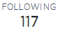
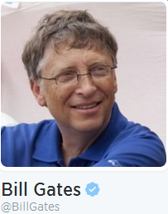
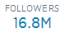
Fraudulent Behavior Patterns
Notes:
Here is a normal user created by someone in Tsinghua a few years ago. It’s not very active. It just follows 117 users. I guess it’s because of the Internet policy of Chinese government. Twitter is blocked. The right-hand is the feature space of followee behavior. Every dot is a followee. We will tag some followees of this account. First, it follows Bill Gates. Bill Gates has a big value of in-degree and authoritativeness.

Slide 20

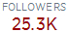
Fraudulent Behavior Patterns
Notes:
It also follows CMU. CMU is here. The second triangle.

Slide 21

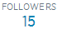
Fraudulent Behavior Patterns
Notes:
It follows an account called Shanch GUO who was an MBA in Tsinghua, but he has only 15 followers and he is here, the last one.

Slide 22
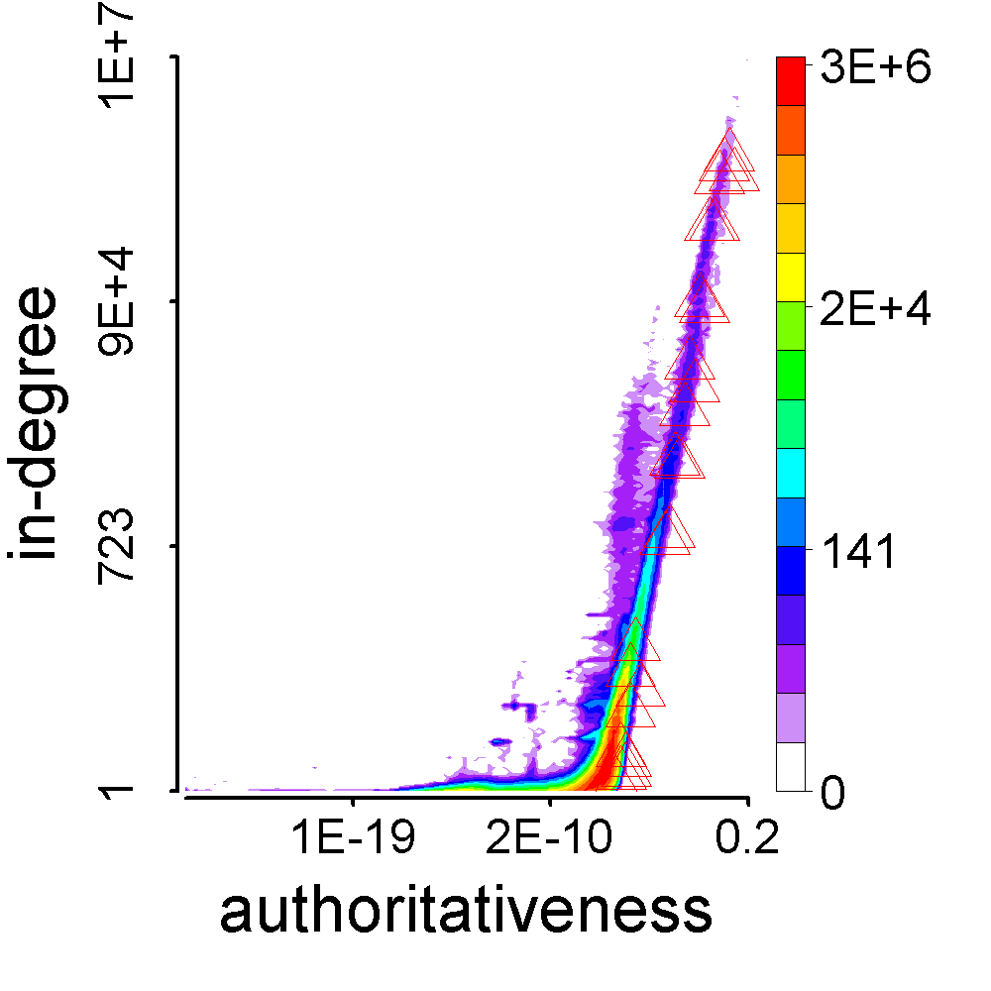
Fraudulent Behavior Patterns
Notes:
Let’s plot all the followees of Tsinghua. We can see their positions are diverse in the feature space. Normal users like you and me usually follow some famous people and also they follow ordinary people like their friends, relatives or classmates.

Slide 23
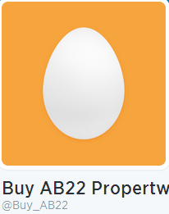
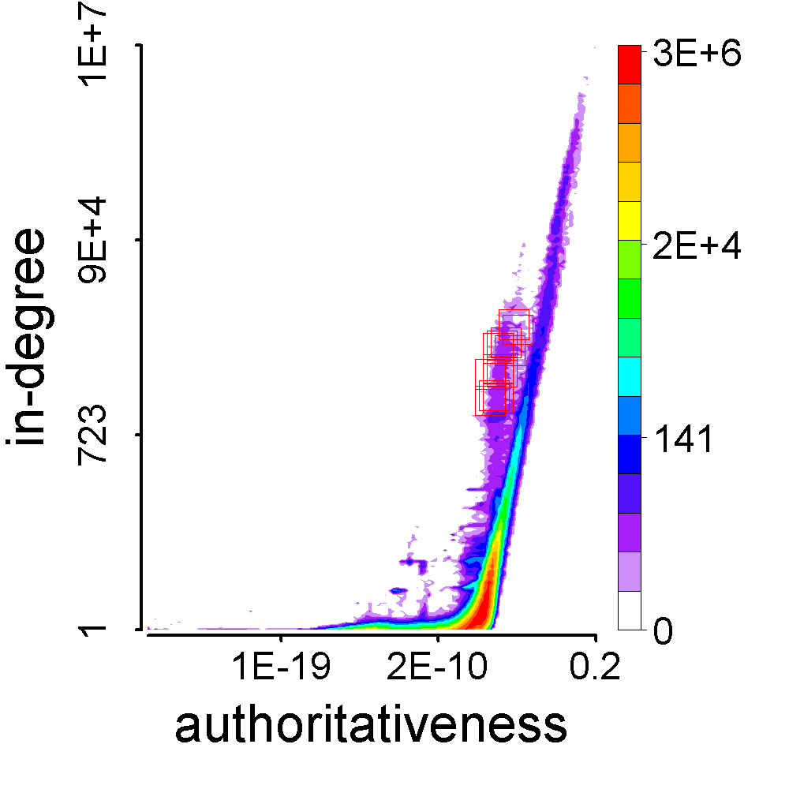
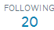

Fraudulent Behavior Patterns
Notes:
Now let’s see the followees of Buy_AB22. The squares are his followees. They are very close to each other. They wanted to look famous and they did. But they could not be as famous as Bill Gates, because they would be easily caught by Twitter company.

Slide 24
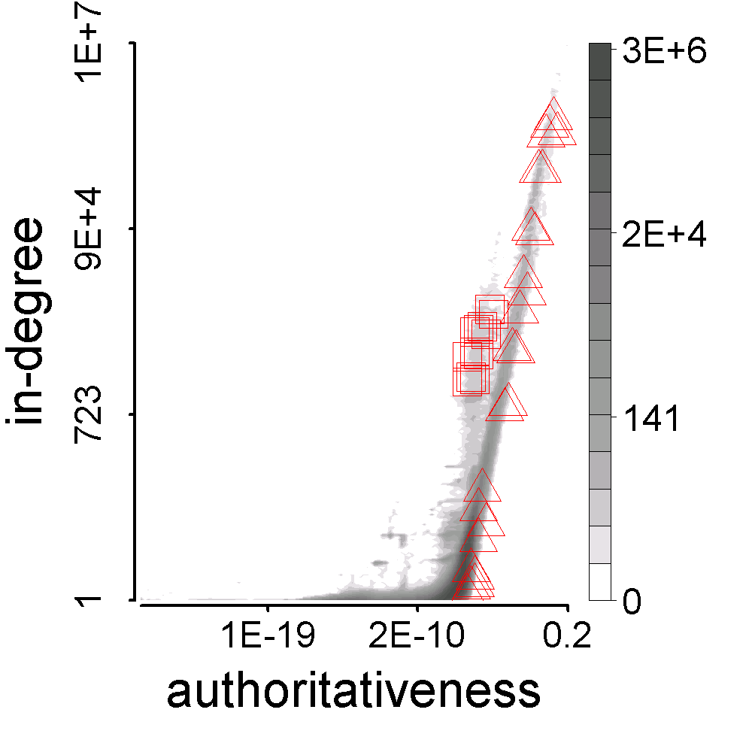
Fraudulent Behavior Patterns
Synchronized
Abnormal
Notes:
To see it more clearly, we plot the feature space in Gray. The triangles are followees of Tsinghua. The squares are followees of Buy_AB22. Now we can see the fraudster Buy_AB22 consistently connects to similar people. We call it synchronized. Another observation is his followees are very different from the majority in the network. We call it abnormal. These two are basic characteristics of fraudulent behavior patterns.

Slide 25
Outline
1. Background
2. Fraudulent Pattern
3. The Algorithm
4. Experiments
Notes:
Now based on the patterns, we can devise an algorithm.

Slide 26
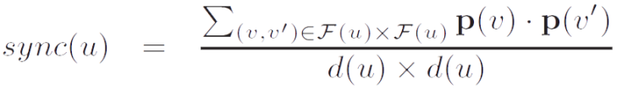
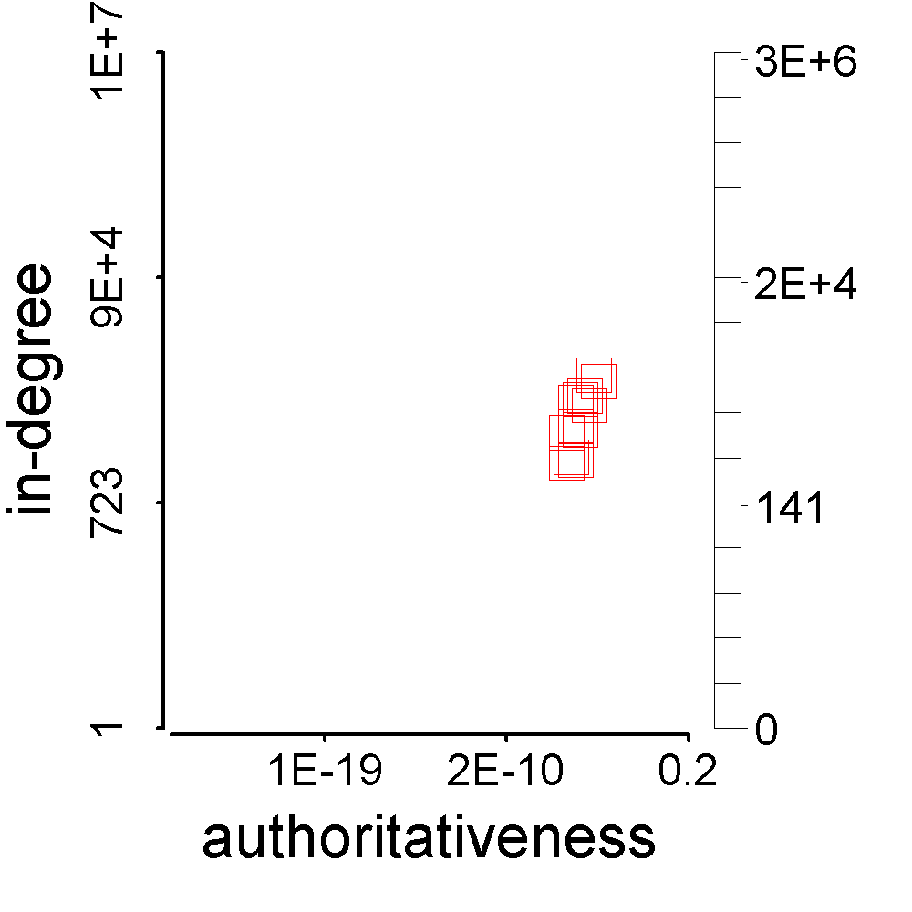
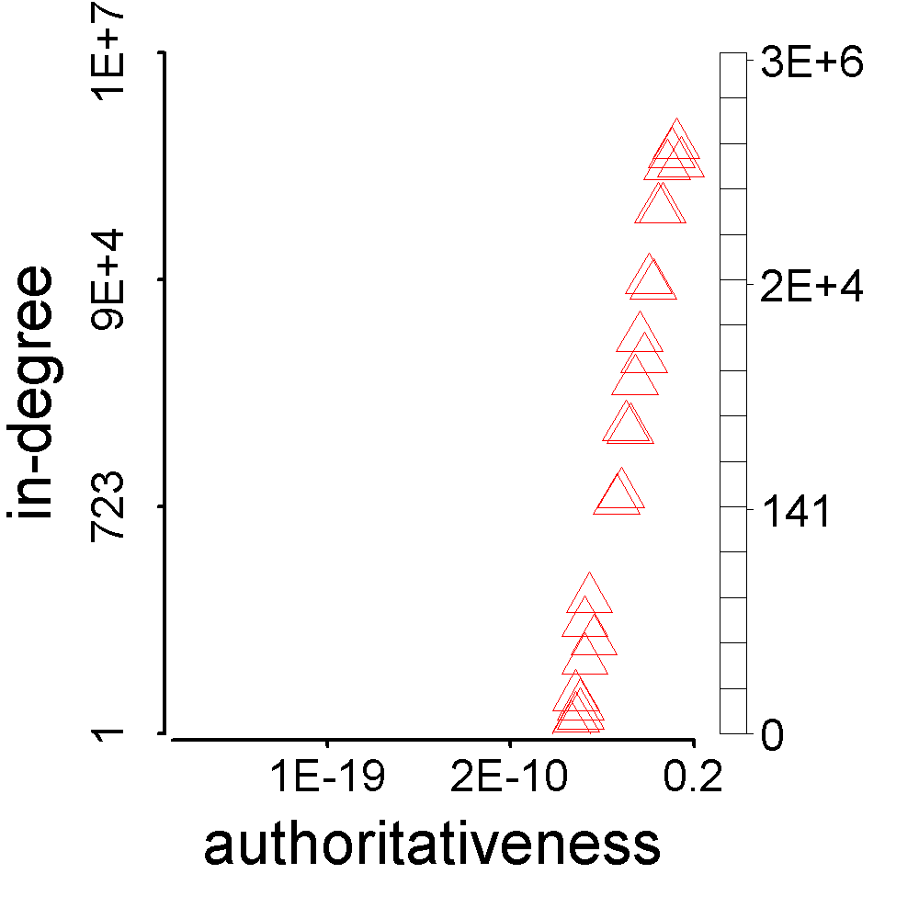
Synchronicity and Normality
Synchronicity
Notes:
We give two concepts, synchronicity and normality to describe the behavior pattern. Synchronicity is computed as average similarity between each pair in one’s followee set. Square vs Square. Triangle vs Triangle.

Slide 27
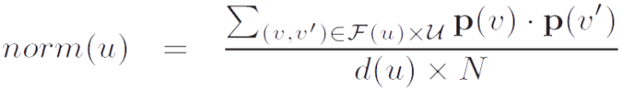
Synchronicity and Normality
Normality
Notes:
Normality is computed as average similarity between each followee and every single node in the feature space.

Slide 28
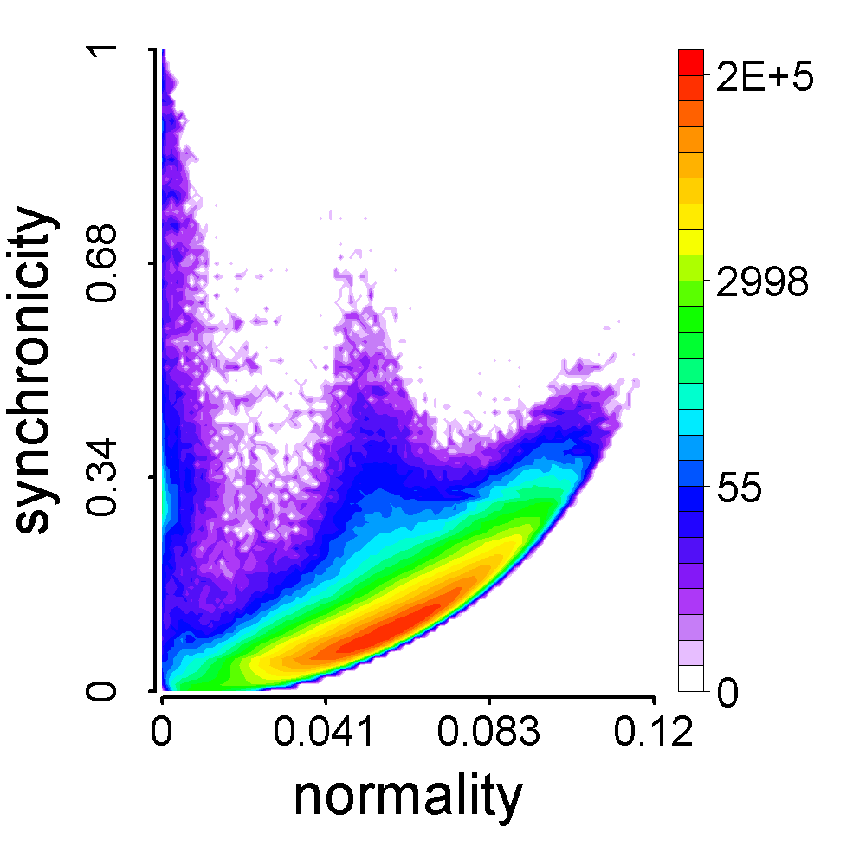
Synchronicity-Normality Plot
Notes:
Now we can plot the synchronicity and normality in the same figure. Every dot is a user as a follower. Normal users like Tsinghua are in the densest part in synchronicity-normality plot. Fraudster like Buy_AB22 have very big synchronicity and very small normality because their behavior patterns are synchronized and abnormal.

Slide 29
Theorem
For any distribution, there is a parabolic lower limit in the synchronicity-normality plot.
Proof. See our paper ☺
synchronicity
normality
Notes:
About the synchronicity-normality plot, we give a theorem to prove the lower limit in our paper. It is parabolic, no matter what the distribution is. The real data shows exactly a parabola on the lower bound.

Slide 30
CatchSync Algorithm
Distance-based
anomaly detection
Fraudsters
Big synchronicity
Small normality
Away from the densest
Notes:
Now we can develop a distance-based anomaly detection algorithm to find fraudsters who have big synchronicity and small normality and away from the densest. We call it CatchSync.

Slide 31
Outline
1. Background
2. Fraudulent Pattern Mining
3. The Algorithm
4. Experiments
Notes:
Now let’s see the experiments.

Slide 32
Experiments
Q1: Does CatchSync remove anomalies?
Degree distribution
Feature space
Q2: Is CatchSync catching actually fraudulent users?
Q3: Is CatchSync robust?
Notes:
In the experiments, we want to answer three questions: first, does CatchSync remove anomalies? We will check the degree distribution and feature space; second, is CatchSync catching actually fraudulent users?; third, is CatchSync robust?

Slide 33
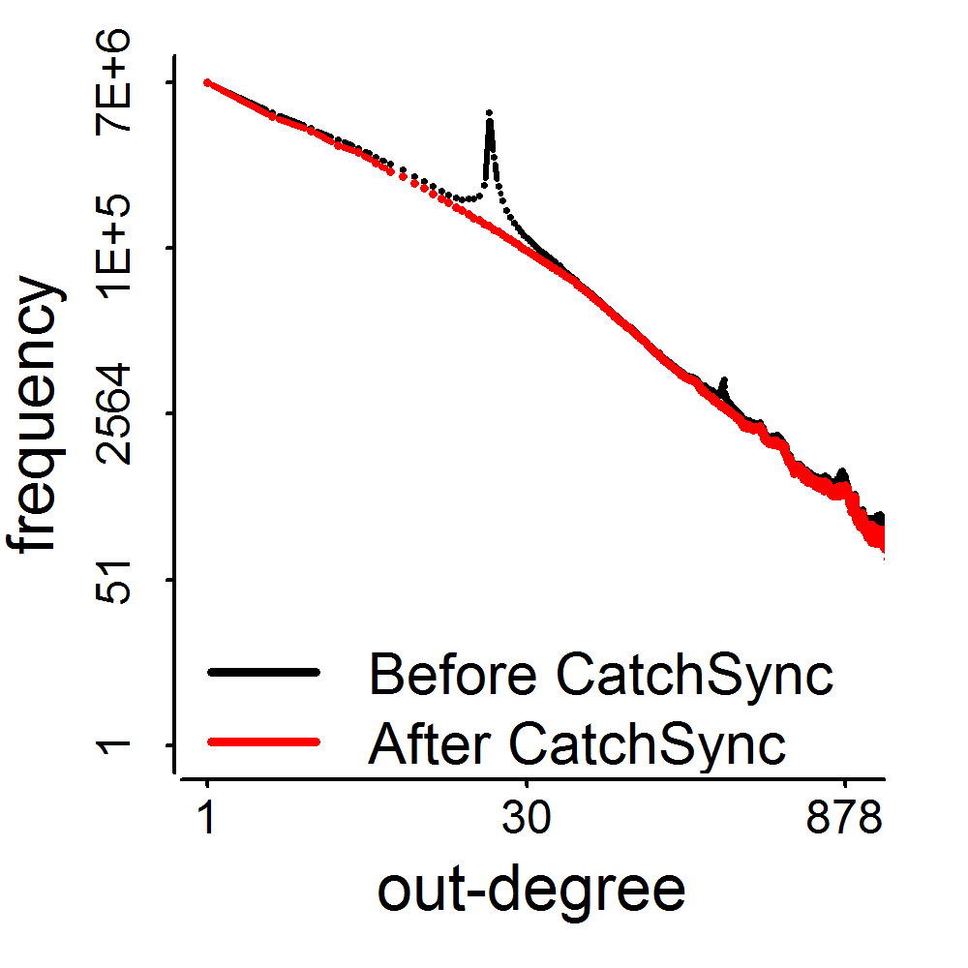
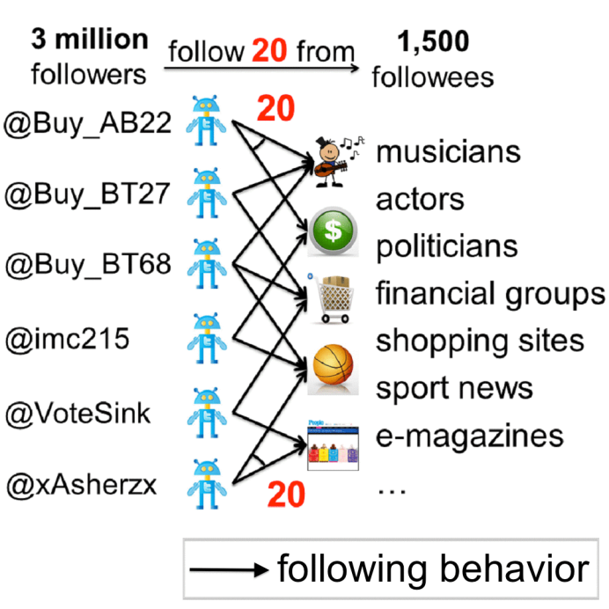
Q1: Does CatchSync Remove Anomalies?
2009
3.17M
41M
0.41M
d=20
Notes:
How let’s see what we have after we remove anomalous edges from Twitter graph. The red curve is our new degree distribution. It looks smooth and looks like power-law. From the results, we find around 3 million accounts consistently connect to exactly 20 from a pool of 1,500 users who are Internet Marketers, shopping sites or financial groups who need a big number of followers.

Slide 34
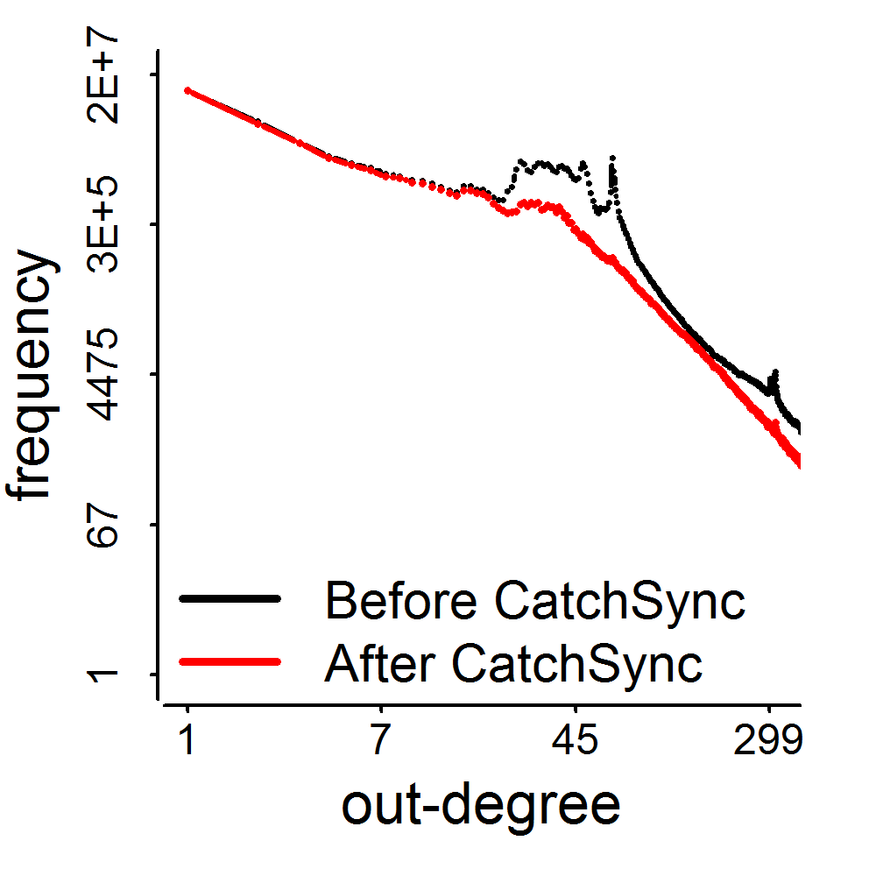
Q1: Does CatchSync Remove Anomalies?
2011
117M
Notes:
We also can see the distribution is smoother on Tencent Weibo after we run CatchSync.

Slide 35
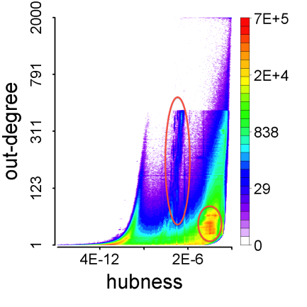
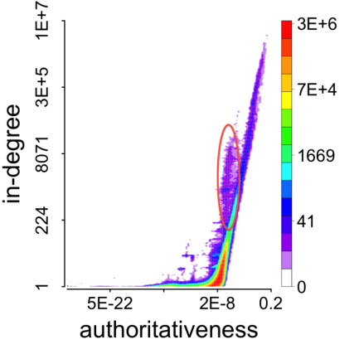
Before CatchSync
Follower
behavior
Followee
behavior
Notes:
Also we check the feature space. Before CatchSync, we can see anomalies like stripes away from the majority.

Slide 36
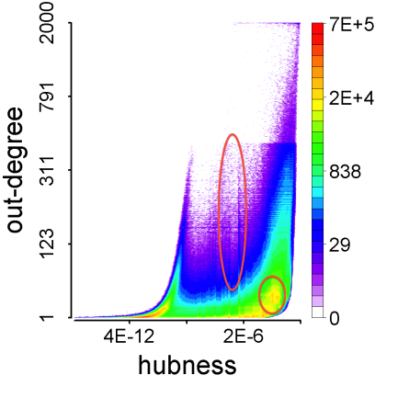
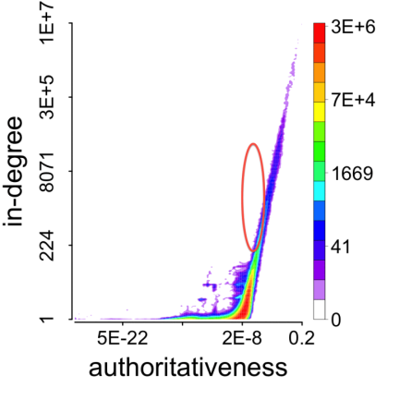
After CatchSync
Follower
behavior
Followee
behavior
Notes:
After CatchSync, the stripes disappear. The suspicious accounts that we remove with CatchSync are exactly the anomalies in these feature spaces.

Slide 37
Q2: Is CatchSync Catching Actually Fraudulent Users?
173/1,000
237/1,000
Notes:
Second, we want to know if the users we caught are actually fraudulent? We random sample 1,000 account who have the degree values around the spikes. And then we ask 5 volunteers to take a look at their profiles to label them as fraudsters or normal users. They are fraudsters if at least 3 volunteers think they are. We have 173 fraudsters from Twitter data and 237 from Tencent Weibo.

Slide 38
Q2: Is CatchSync Catching Actually Fraudulent Users?
CatchSync
+SPOT
CatchSync
SPOT
OutRank
Notes:
Then we use random walk-based method OutRank, content-based method SPOT, and our method CatchSync to catch them. Content-based SPOT means it learns profiles and tweets, like does the account have profile photo and … the number of tweets. Our accuracy is 0.751 – much higher than SPOT and OutRank. The interesting thing is if we blame fraudsters caught by either CatchSync for suspicious behavior or SPOT for suspicious content, we can have a better performance to 0.813, which means these two methods are complementary. We suggest Twitter company to capture fraudulent behaviors. I believe they have got a large vocabulary of suspicious content.

Slide 39
Q2: Is CatchSync Catching Actually Fraudulent Users?
CatchSync
+SPOT
CatchSync
SPOT
OutRank
Notes:
On Tencent Weibo, CatchSync is also better than SPOT and the combination is much better.

Slide 40
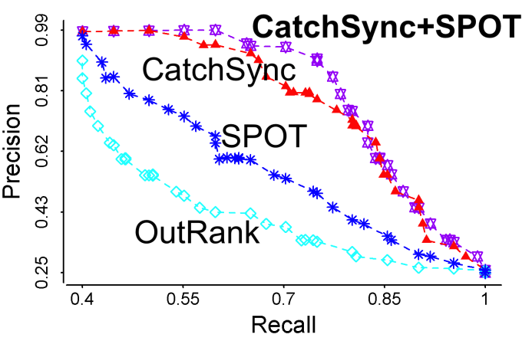
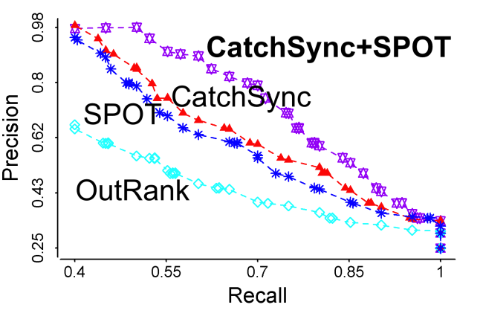
Q2: Is CatchSync Catching Actually Fraudulent Users?
Recall = 80% | Precision in Twitter | Precision in Tencent Weibo
 | 83.5% | 79.4%
Notes:
Also we give the precision-recall curves to further demonstrate our effectiveness.

Slide 41


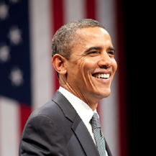
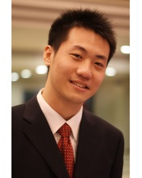
Q3: Is CatchSync Robust to Camouflage?
Target
Popular
camouflage
Random
camouflage
Notes:
Fraudsters can also be smart when they build their links. For example, besides their targets or customers, they can follow President Obama as “popular” camouflage. They can also follow some random user like you and me for camouflage. We want to know if our CatchSync is robust to the camouflage.

Slide 42


Q3: Is CatchSync Robust to Camouflage?
Notes:
We use synthetic data to test it. First we generate a random power-law graph and then inject synchronized behaviors on it. We can see the followees are shown as outliers in the feature space. And we can catch the injected followers easily in synchronicity-normality plot.

Slide 43


Q3: Is CatchSync Robust to Camouflage?
Notes:
Then we make the injected folllowers to follow 10% more popular nodes and more random nodes. The injected followees are not outliers now. They hide in the feature space. But our synchronicity-normality plot can still find the injected followers who have synchronized and abnormal behaviors.

Slide 44


Q3: Is CatchSync Robust to Camouflage?
Popular
camouflage
Random
camouflage
Notes:
We do experiments on the synthetic data to test the precision and recall when there are popular camouflage or random camouflage. Our CatchSync is close to the ideal. So we claim that CatchSync is robust to camouflage.

Slide 45
Conclusion
Goals
G1. Find patterns that distinguish fraudulent user behavior from normal behavior
A1: Synchronized & Abnormal!
G2. Design algorithms that catch fraudsters
A2: CatchSync!
Remove spikes
Content free
Robust to camouflage
Notes:
Now we conclude our talk. First, we find fraudulent users behave synchronized and abnormal, which can be used to distinguish them from normal users. Second, we design CatchSync algorithm to catch fraudsters. CatchSync can remove spikes in degree distributions, and it’s content free and robust to camouflage. The future work could be using CatchSync to ask humans to label fraudsters in group. It will be more accurate and faster than labeling the account one by one.

Slide 46



Questions?
Meng Jiang
mjiang89@gmail.com
http://www.meng-jiang.com
Notes:
That’s all. Thank you for listening. I am happy to answer your questions now.

